Slide 1
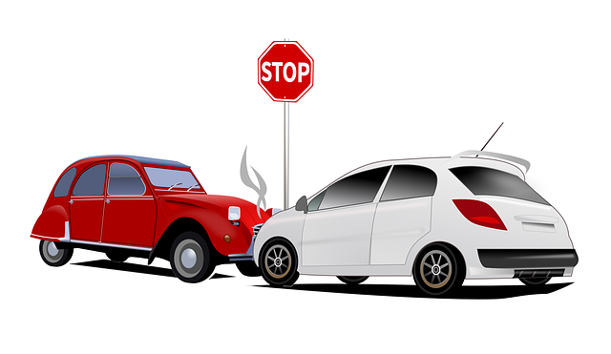
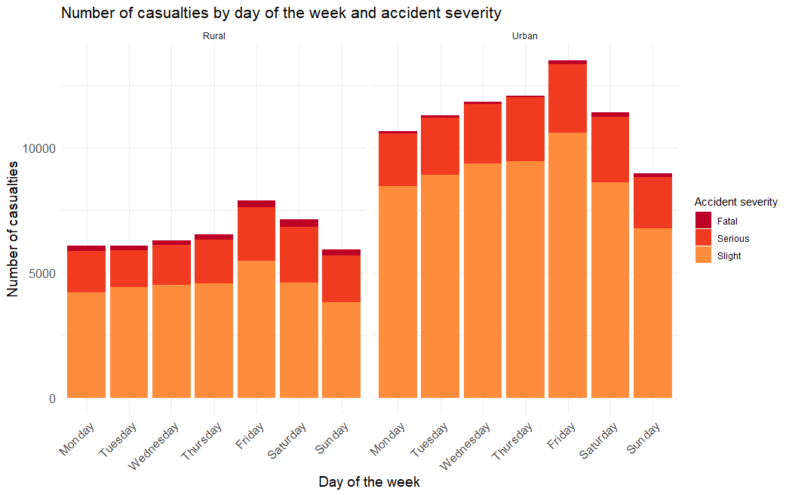
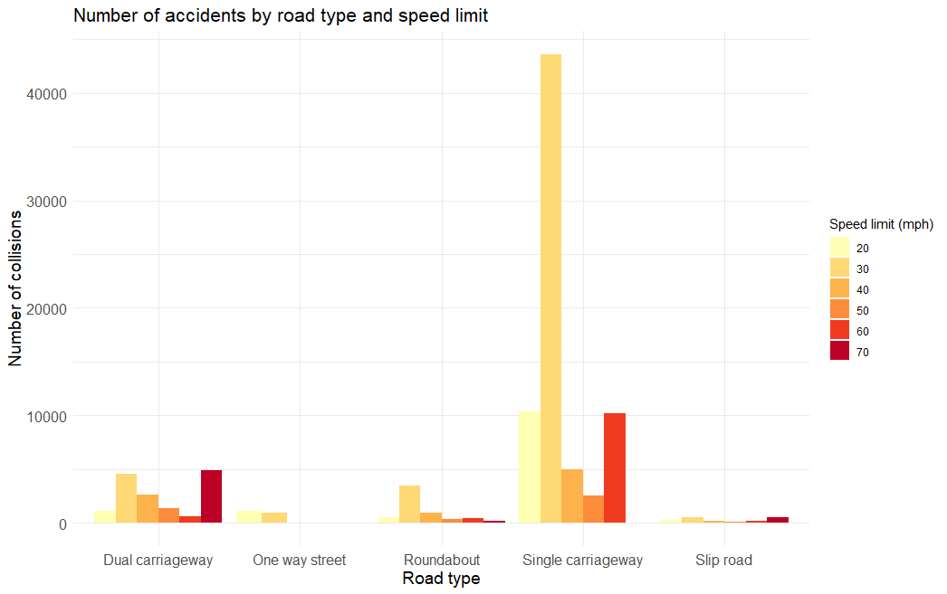
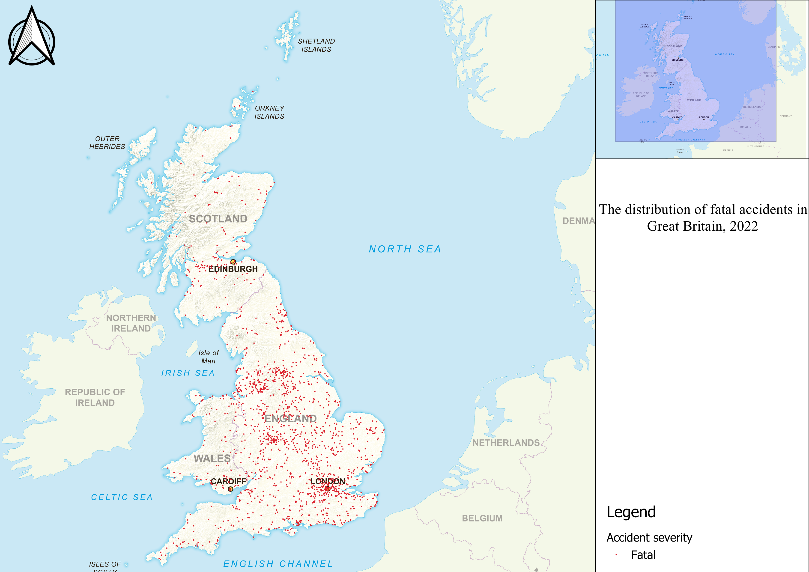
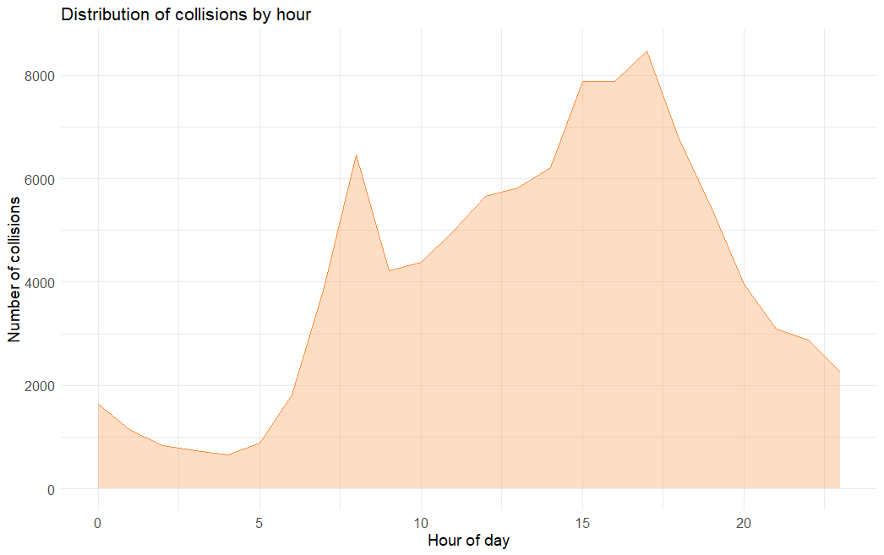
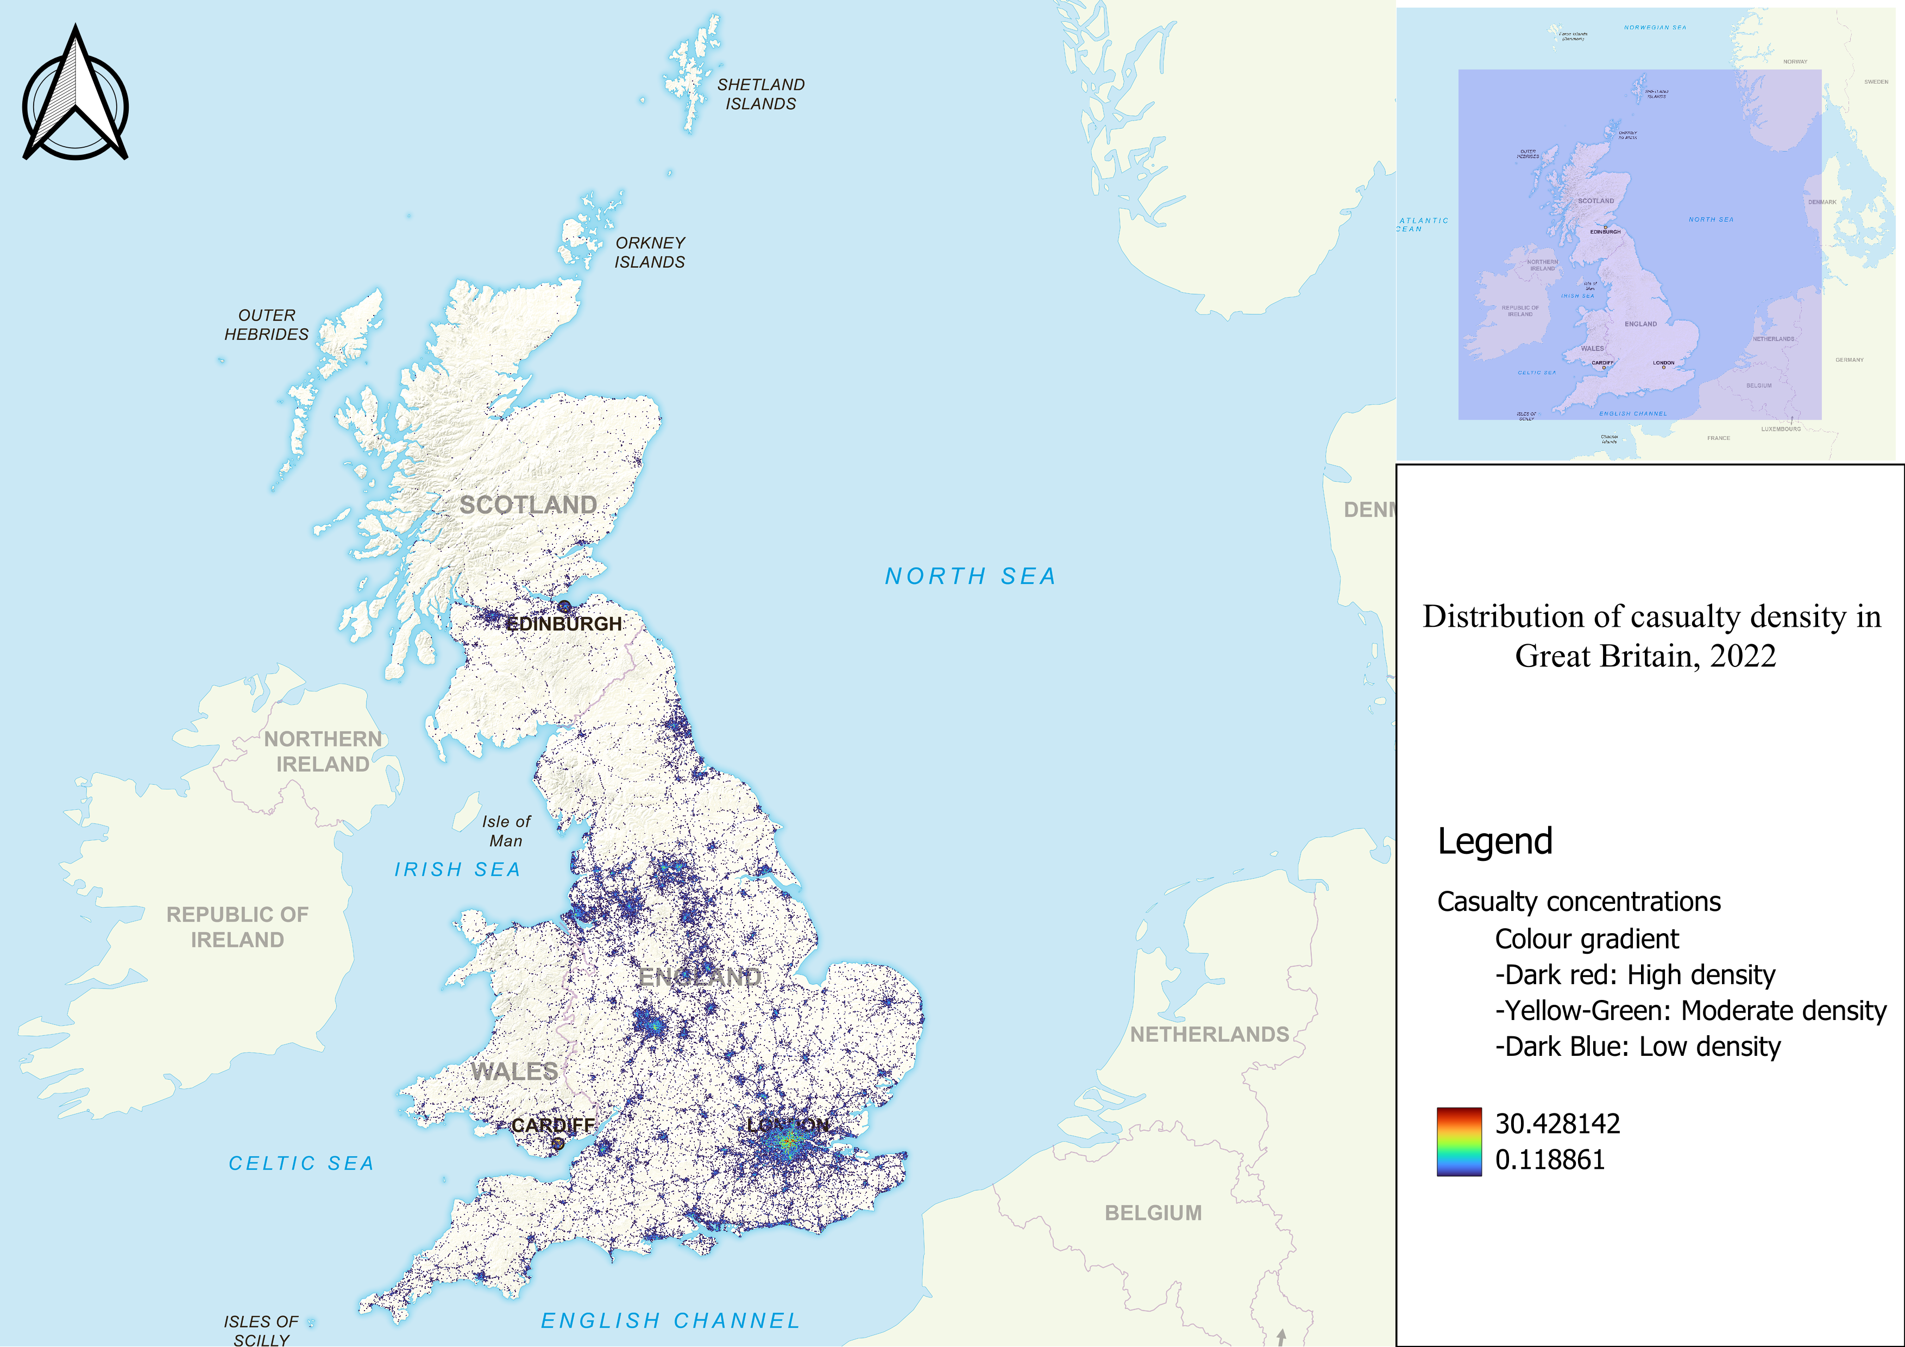
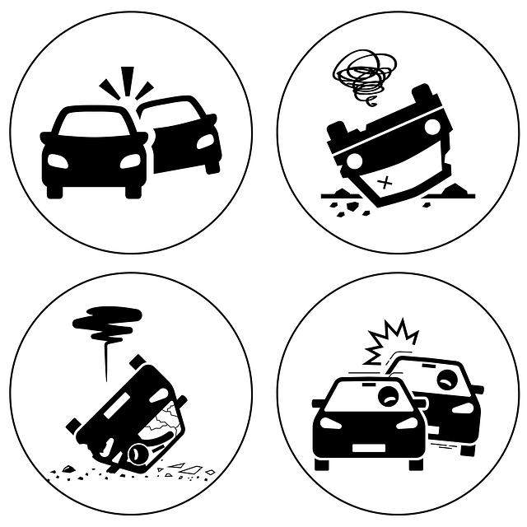

Investigating Road Traffic Collisions in Great Britain in 2022
Background
Road traffic collisions represent a leading cause of unintentional injuries and a significant global health challenge. According to the World Health Organization (WHO), approximately 1.19 million people die each year due to road traffic accidents. Therefore, it is essential to address this major public health concern and alleviate its burden. This poster uses “the Road Safety Data – Collisions” 2022 in Great Britain to provide insights into road traffic collision trends, aiming to inform targeted strategies and enhance road safety in Great Britain.
Methods
Data source
The dataset for this poster “The Road Safety Data – Collisions” was sourced from the UK government website. This dataset included information about road safety and served as the foundation for the analysis.
Data processing
The dataset underwent thorough preprocessing to ensure data quality. Steps included handling missing values, and formatting variables.
Geospatial analysis
QGIS software was employed for geospatial analysis and the creation of maps. It allowed the visualisation of spatial patterns and the identification of geographic clusters related to road traffic collisions.
Data visualisation
RStudio, an integrated development environment for the R programming language, was utilised for the creation of charts.
Results
Fatal accidents were more concentrated in large cities such as London, Birmingham, Leeds, and Liverpool.
The incidence of casualties rose in correlation with population density, under the assumption that larger cities harbor bigger populations. London presents the most dangerous accidents with a high number of casualties.
Urban areas witnessed a larger number of casualties. Both urban and rural areas showed a peak of casualties on Fridays. Collisions in rural settings were more lethal compared with urban ones.
Single carriageways with a speed limit of 30 mph represented over four times the number of accidents compared to other road types.
The number of collisions was notably high during rush hours. There was a peak of collisions around 5 pm that exceeded 8000 accidents.
Conclusion
In conclusion, the findings reveal a higher incidence of lethal accidents in big cities like London, Birmingham, Leeds, and Liverpool. The correlation between casualties and population density emphasises the need for targeted safety measures. Urban areas witness a higher number of casualties, with Fridays showing a peak in both urban and rural areas. Additionally, the alarming frequency of accidents on single-carriageways with a 30-mph speed limit accentuates the necessity for focused interventions on these road types. Therefore, implementing tailored policies is crucial to reduce the burden of road traffic accidents.

